Slide 1
Digital Logic Design
Lecture 01- 02
By : Farhan Ahmed Jamro

Slide 2
Introduction
Digital Logic Design
Working with circuits
Combinational Circuit
Can’t store Data
Sequential Circuit
Can store data .
Number System
Decimal
Binary
Hex Decimal
Octal
How computer system
work with number
State of electrical signal
Gates
Boolean Algebra
K-Map
Etc

Slide 3
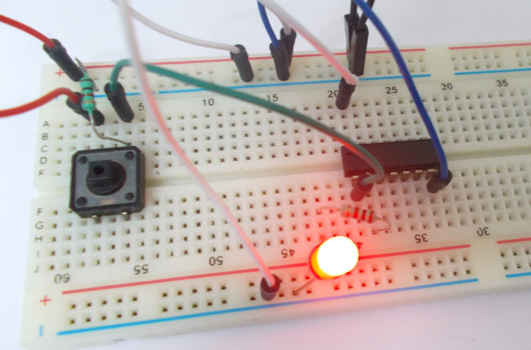
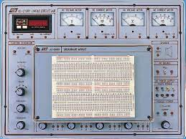
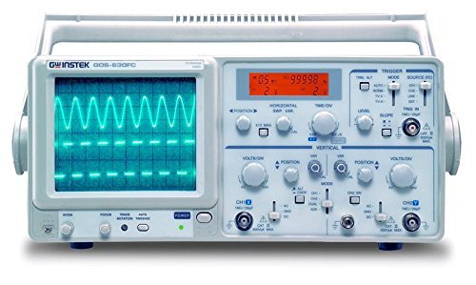
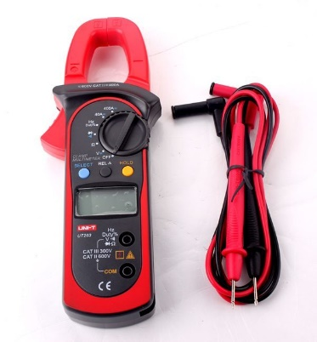
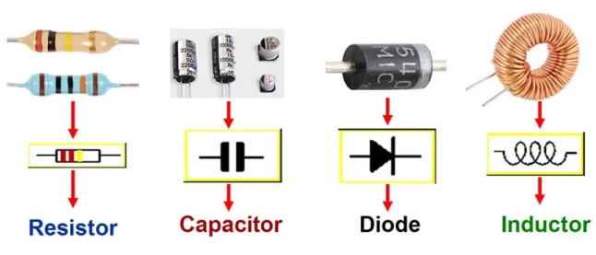
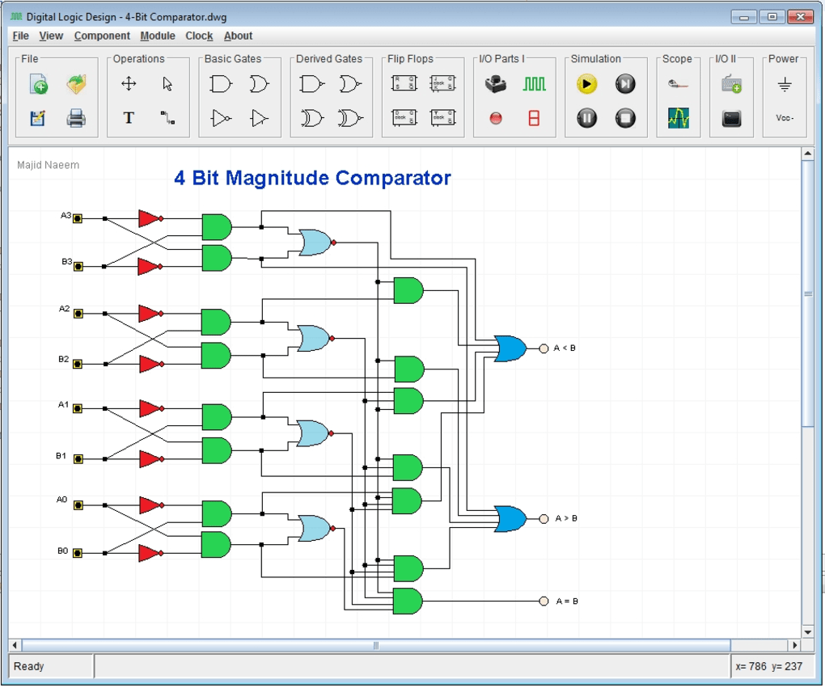
Equipment and Simulation in DLD

Slide 4
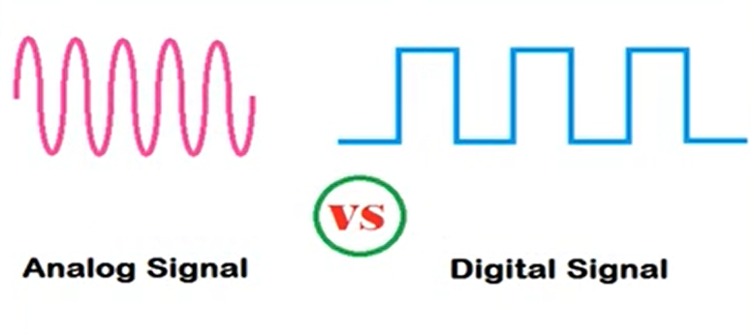
Digital and Analog Quantities

Slide 5
Digital and Analog Quantities
The quantity that has continuous values is called as the analog quantity. Example of analog quantities are time, temperature, pressure, distance and sound.
Most natural quantities that we see are analog and vary continuously. Analog systems can generally handle higher power than digital systems.

Slide 6
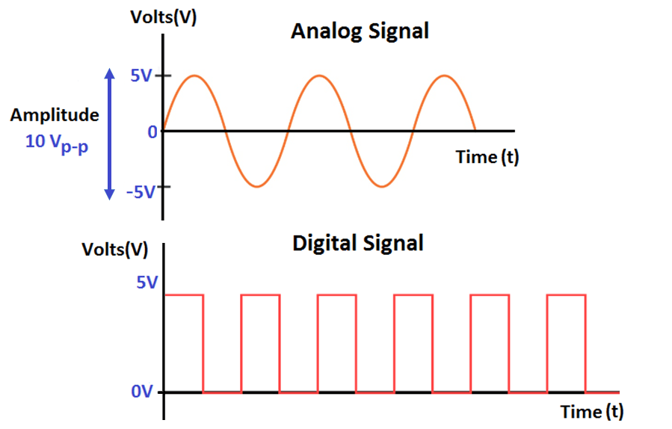
Analog Quantities
Examples of analog signals:
The signals include audio signals transmitted through wires, video signals broadcasted using older technology, radio signals, and analog watches

Slide 7
Digital Quantities
A digital quantity is one having a discrete set of values.

Slide 8
Digital and Analog Quantities
Analog and digital signals are the types of signals carrying information. The major difference between both signals is that the analog signals have continuous electrical signals, while digital signals have non-continuous electrical signals.
Digital circuits are more reliable. Digital circuits are easy to design and cheaper than analog circuits. The hardware implementation in digital circuits, is more flexible than analog. The occurrence of cross-talk is very rare in digital communication.

Slide 9
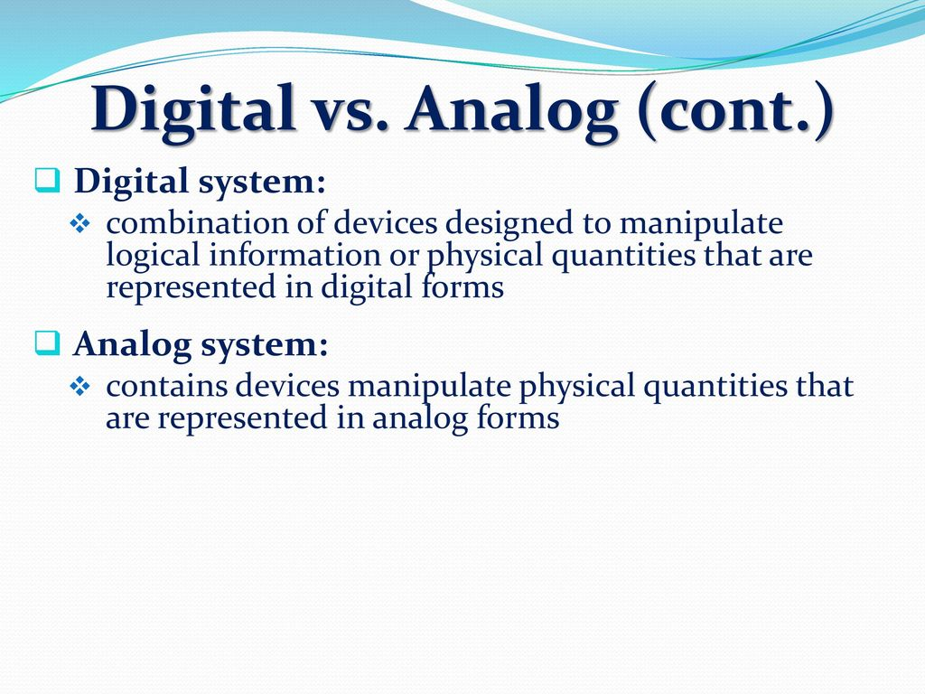
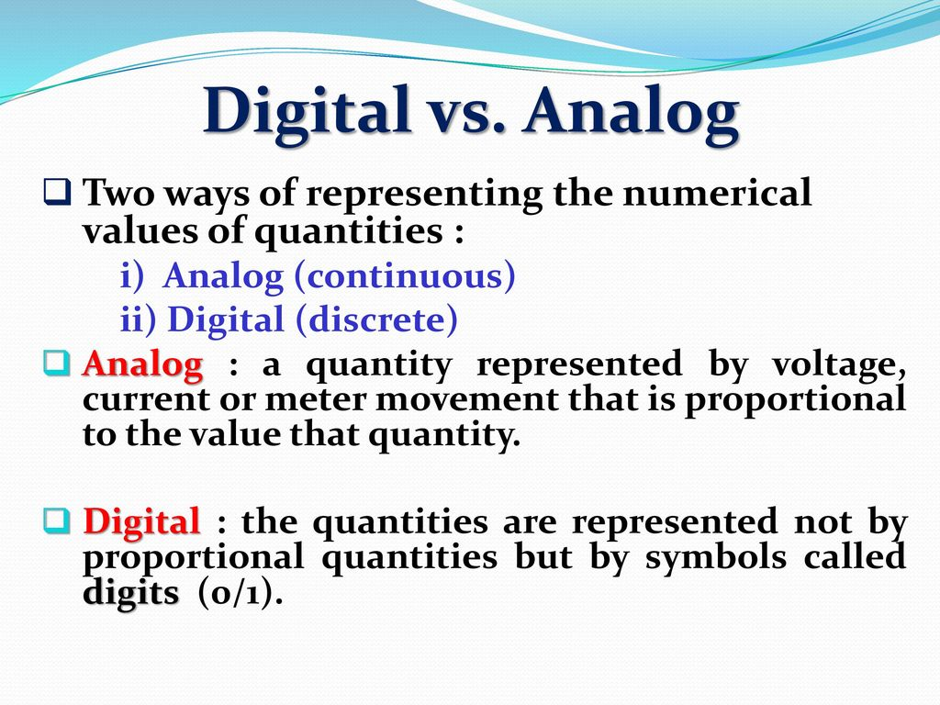

Slide 10
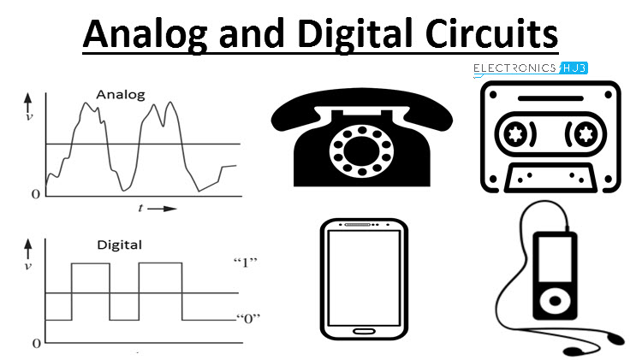
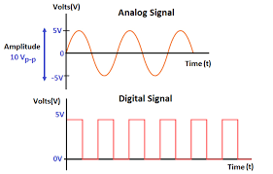
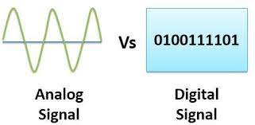
Digital and Analog Quantities

Slide 11
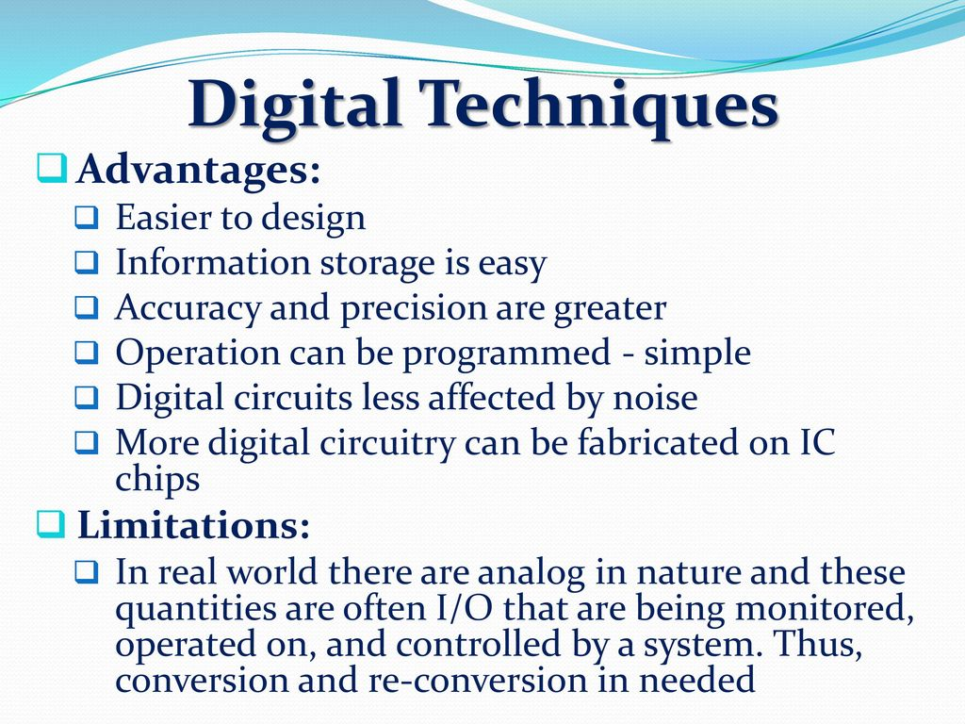
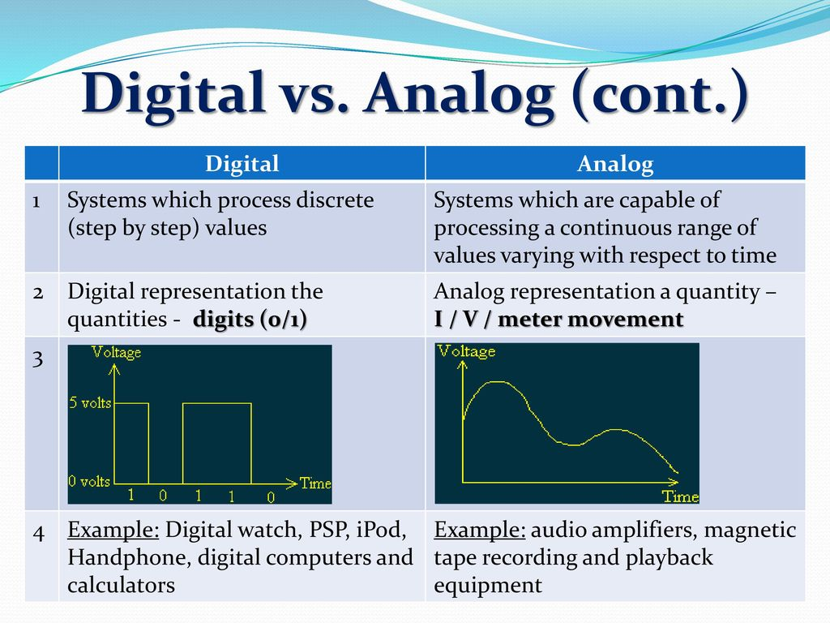

Slide 12
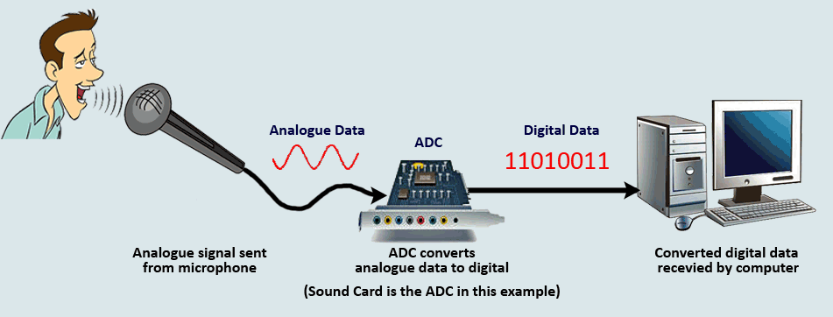
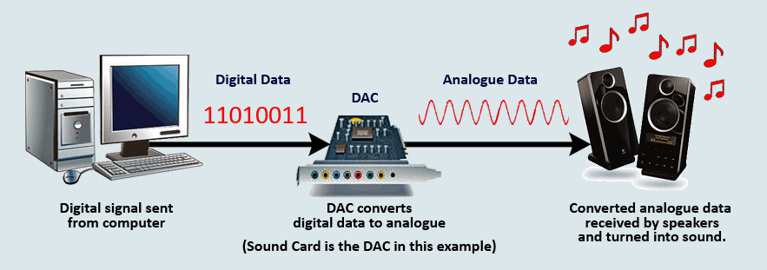
Limitation
Analog to Digital Converter and Digital to analog
A circuit that can convert analog signal to digital signal is called ADC.
Analog to Digital
Digital to Analog

Slide 13
Binary Digits, Logic Levels, and Digital
Because there are only two valid Boolean values for representing either a logic “1” or a logic “0”, makes the system of using Binary Numbers ideal for use in digital or electronic circuits and systems.
In digital systems theses voltages are called “logic levels” and ideally one voltage level represents a “HIGH” state, while another different and lower voltage level represents a “LOW” state. A binary number system uses both of these two states

Slide 14
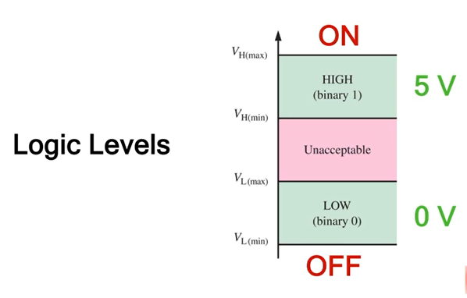
Binary Digits, Logic Levels, and Digital
A logic level is a specific voltage or a state in which a signal can exist.
We often refer to the two states in a digital circuit to be ON or OFF.
Represented in binary, an ON translates to a binary 1, and an OFF translates to a binary 0.

Slide 15
Binary Digits, Logic Levels, and Digital
Digital electronics uses circuits that have two states, which are represented by two different voltage levels called HIGH and LOW.
The voltages represent numbers in the binary system.
VH(max)In binary, a single number is called a bit (for binary digit).
A bit can have the value of either a 0 or a 1, depending on if the voltage is HIGH or LOW.
HIGH VH(min)
Invalid VL(max)
LOW VL(min)

Slide 16
Waveforms
Digital waveforms change between the LOW and HIGH levels. A positive going pulse is one that goes from a normally LOW logic level to a HIGH level and then back again. Digital waveforms are made up of a series of pulses.
Actual pulses are not ideal but are described by the rise time, fall time, amplitude, and other characteristics.

Slide 17
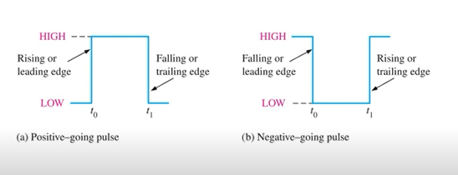
Digital Waveforms

Slide 18
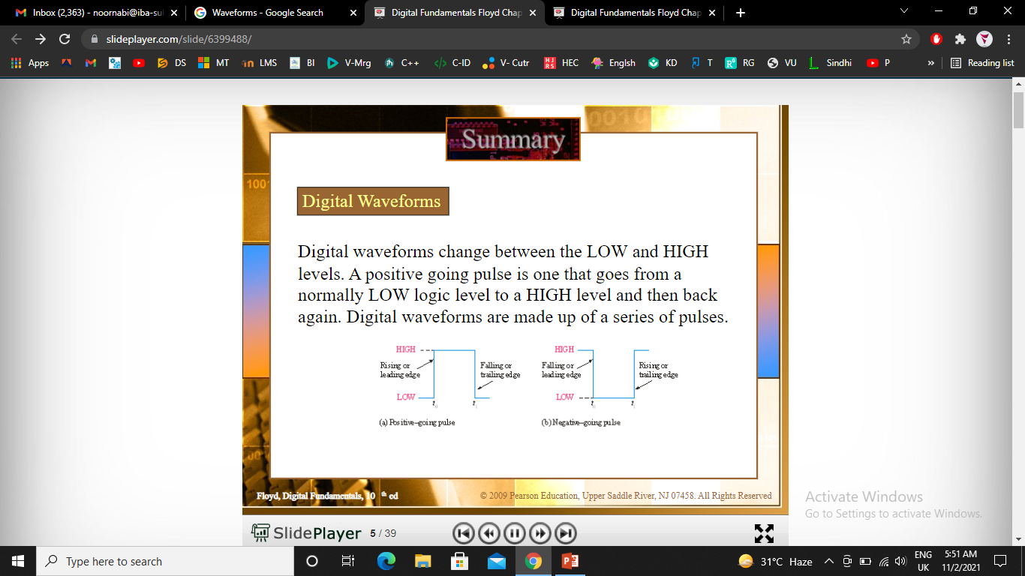

Slide 19
